Slide 1
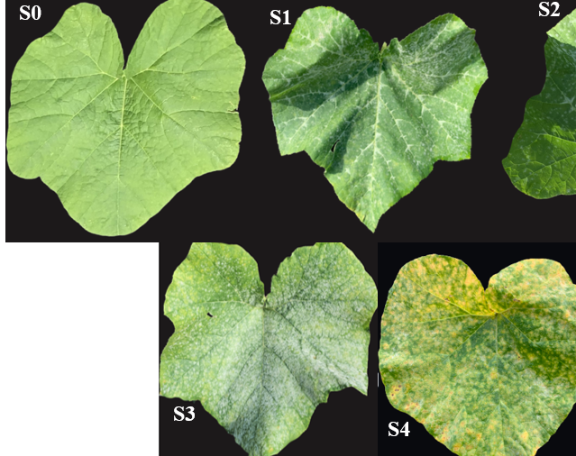
Screening for Resistance of cucurbit Genotypes to Cucurbit Powdery Mildew
BIOL 806 FINAL PROJECT
FALL 2023
By:
Joshua Addo
Julia Oliveira Barreiro De Jesus

Slide 2
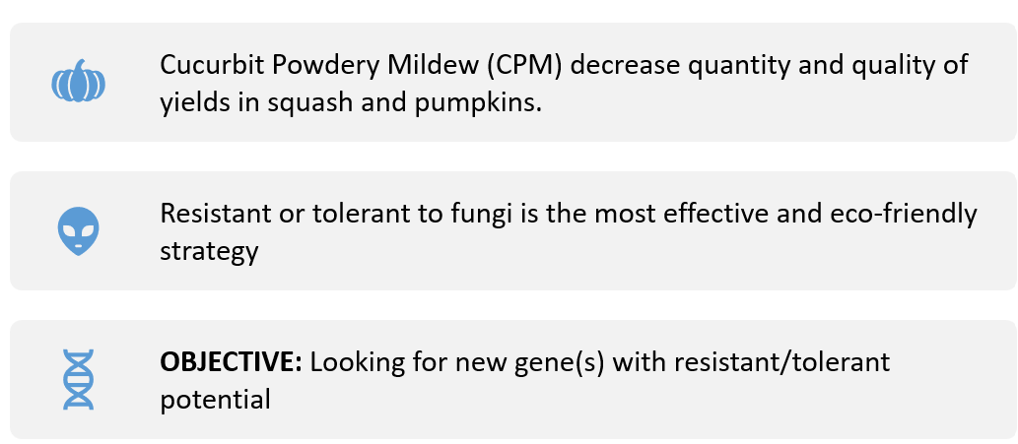
INTRODUCTION

Slide 3
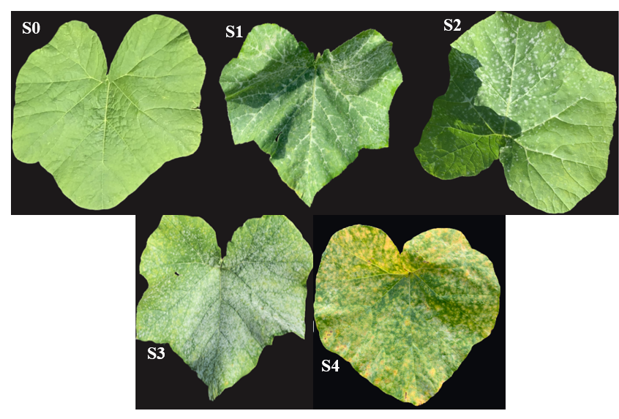
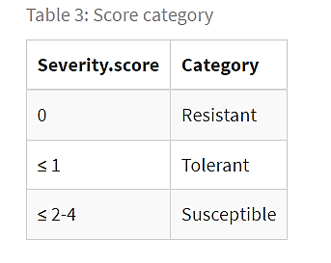
METHOD
Table 1: category score
Figure 1: Schematic figure to guide the indexing of CPM severity on leaves

Slide 4
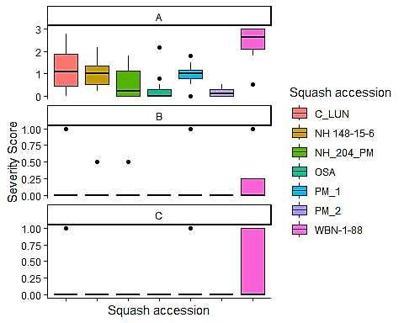
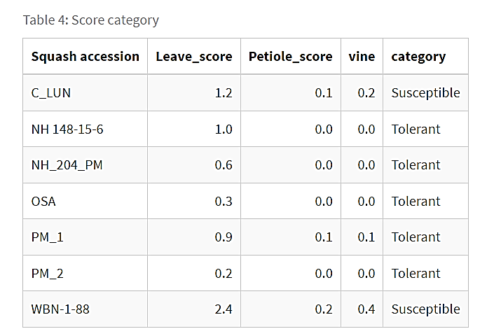
RESULTS
Table 2: severity score and category
Figure 2: CPM severity on leave (A) petiole (B) and vine (C) of the squash accessions

Slide 5
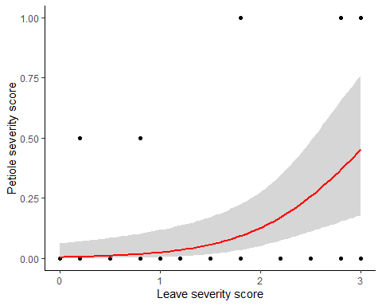
RESULTS
A generalized linear regression model indicated that there was significant prediction between CPM infection on leaves and petioles (p <0.05)
Figure 3: Relationship between mean leave severity score and petiole severity scores, including best fit line

Slide 6

CONCLUSION
Descriptive and categorical analysis concluded that C_LUN and WBN-1-88 are susceptible squash accessions while identifying the other five accessions (PM_1, NH 148-15-6, NH_204_PM, OSA, and PM_2) as tolerant to CPM infection.
Molecular analysis would be needed to identify gene(s) for further breeding and selection

Slide 7
BIBLIOGRAPHY
McGrath, M.T. (2022). Cucurbit Powdery Mildew | Cornell Vegetables.. https://www.vegetables.cornell.edu/pest-management/disease-factsheets/cucurbit-powdery-mildew/

